Slide 1
Image Manipulation GUI
GUI that enables the user to load, modify and save images

Slide 2
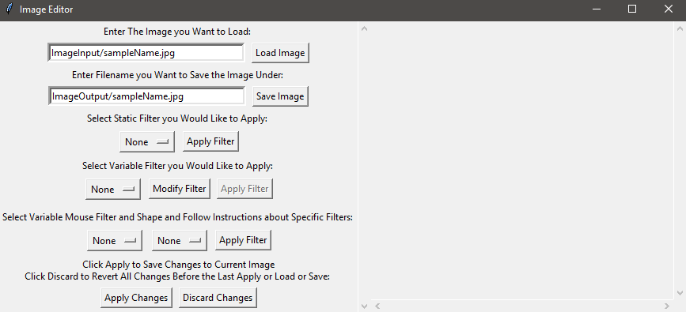
Image Snapshot
Enter the Name of the image in the load field and click load image
Select and apply some filters, if you want to save your changes, you can click apply to save the changes to a buffer and click discard changes to revert to the buffer
Save the image when complete under a filename of your choosing

Slide 3
Live Demo
Show loading an image, stacking some filters and save a result

